Slide 1
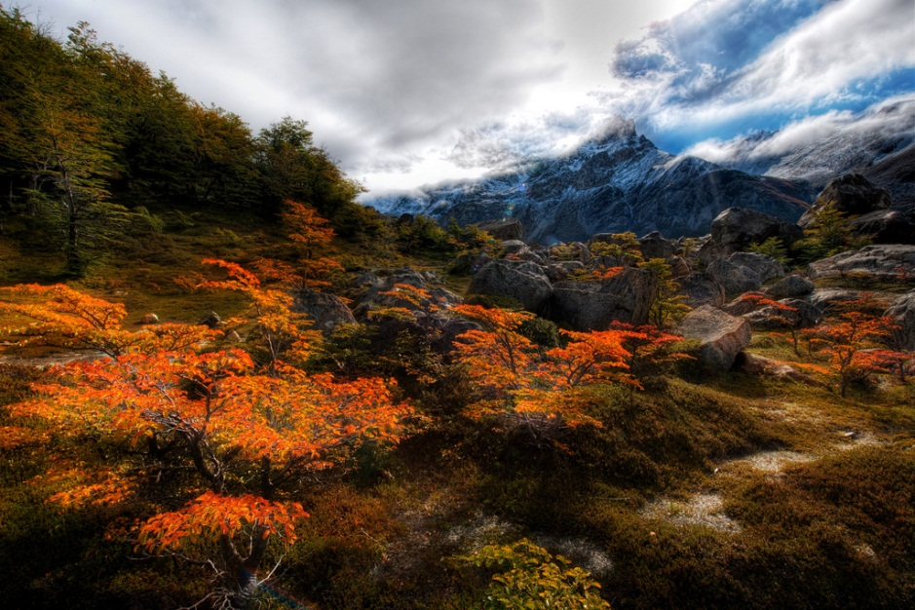
WELCOME TO LIFE
A GUIDE FOR NEW MEMBERS
OF THE HUMAN RACE
by ryan somma

Slide 2
This work is licensed under the Creative Commons Attribution-NonCommercial-ShareAlike 3.0 Unported License. To view a copy of this license, visit http://creativecommons.org/licenses/by-nc-sa/3.0/
All images in this book are licensed under various versions of the Creative Commons license or are in the public domain, please see the photography credits page for links to original images and their licensing.

Slide 3
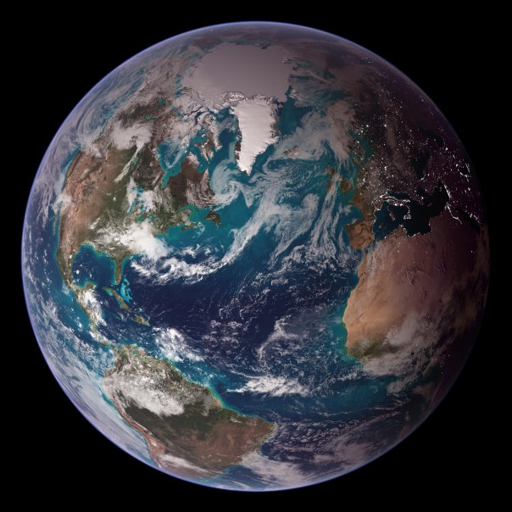
EARTH
SO HERE YOU ARE, LIVING ON A PLANET WE CALL…
EVERYTHING AROUND YOU ALL THE WAY UP TO THE TOP OF THE CLOUDS IS PART OF EARTH.

Slide 4
THAT BIG BRIGHT HOT BALL IN THE SKY DURING THE DAY IS THE SUN OUR EARTH GOES AROUND THE SUN.
EVERY TIME YOU HAVE A BIRTHDAY, THE EARTH HAS GONE ALL THE WAY AROUND THE SUN SINCE YOUR LAST BIRTHDAY!
THE SUN IS A STAR. SO ARE THE OTHER TWINKLING DOTS OF LIGHT IN THE SKY AT NIGHT.

Slide 5
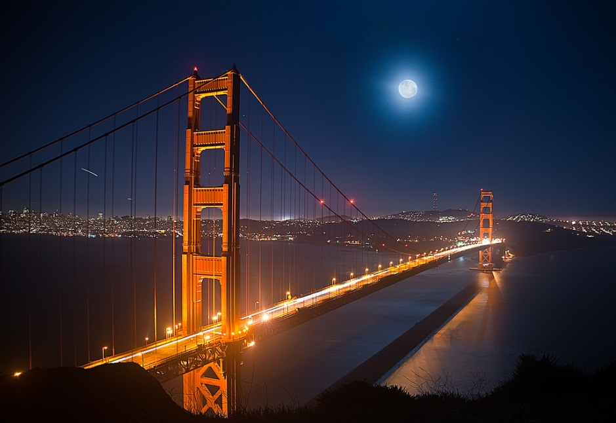
THE BIG GLOWING CIRCLE IN THE SKY AT NIGHT? THAT IS
THE
MOON
THE MOON IS LIKE A PLANET,
BUT IT GOES AROUND THE EARTH.
THE SUN SHINES ON IT TO MAKE IT BRIGHT.
SOME OF US HAVE WALKED ON THE MOON!

Slide 6
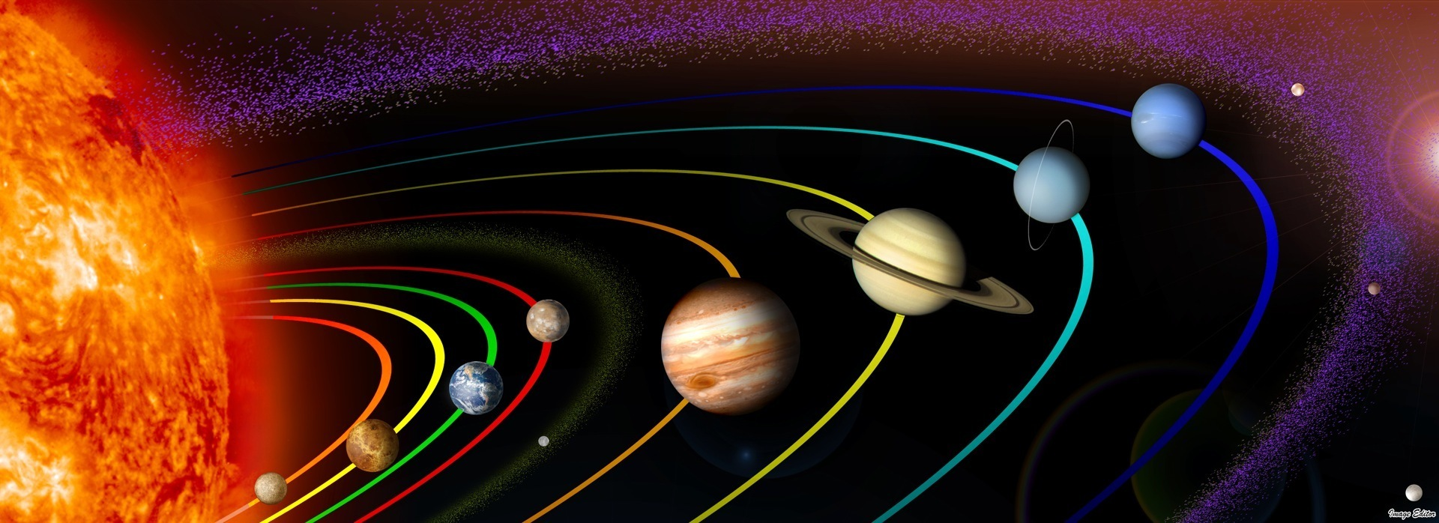
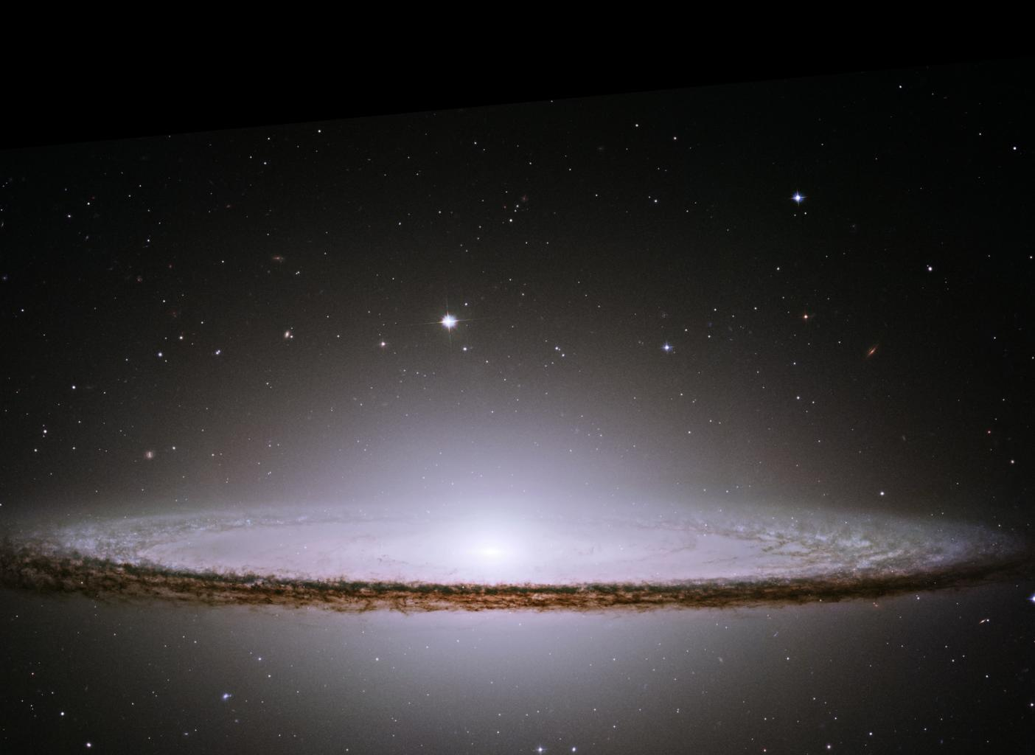
SOME OF THE BRIGHT SPOTS IN THE NIGHT SKY ARE PLANETS TOO. THEY DON’T TWINKLE, BUT THEY DO GO AROUND THE SUN
THE SUN AND OTHER STARS GO AROUND THE MILKY WAY.
THE MILKY WAY IS A GALAXY.
GALAXIES HAVE HUNDREDS OF BILLIONS OF STARS IN THEM.

Slide 7
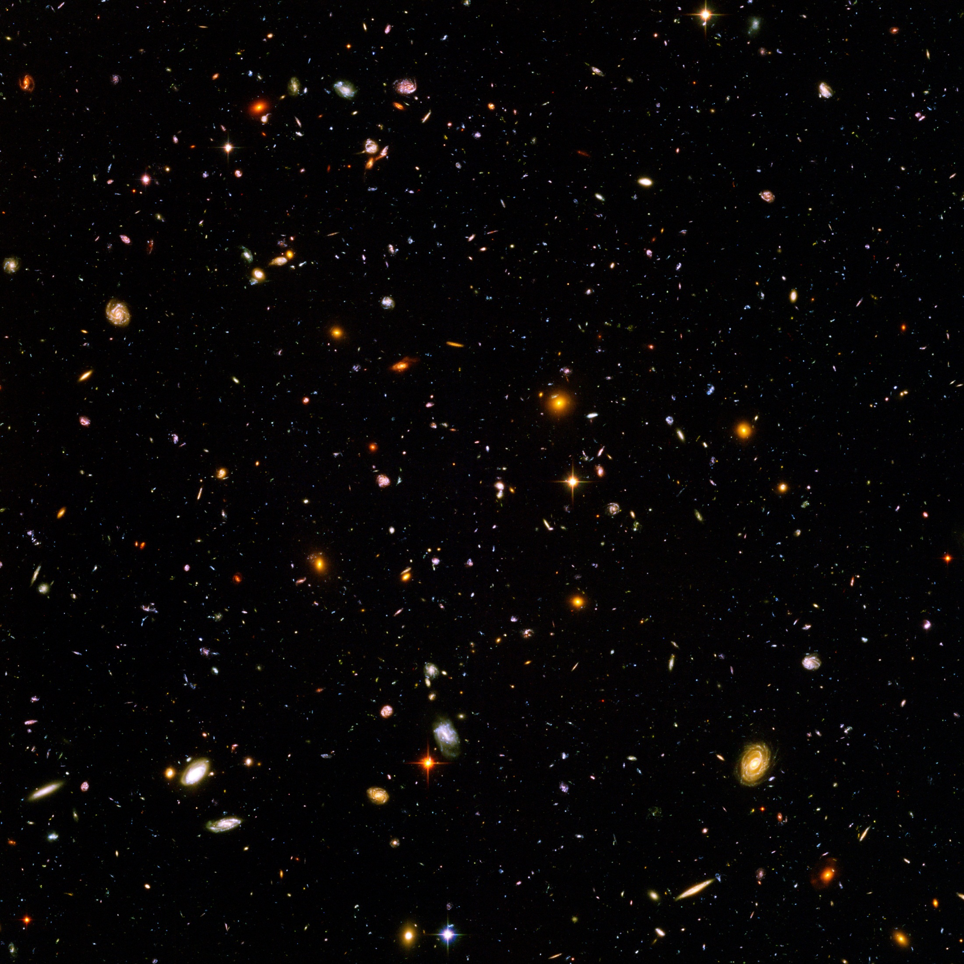
THE SKY IS FILLED WITH GALAXIES. THERE ARE OVER 10,000 GALAXIES ON THIS PAGE AND IT WOULD TAKE 23,700,000 PAGES TO COVER THE NIGHT SKY. ALL OF THESE GALAXIES FILLED WITH STARS CIRCLED BY PLANETS CIRCLED BY MOONS ARE PART OF THE…
UNIVERSE
THE UNIVERSE IS EVERYTHING THERE IS.

Slide 8
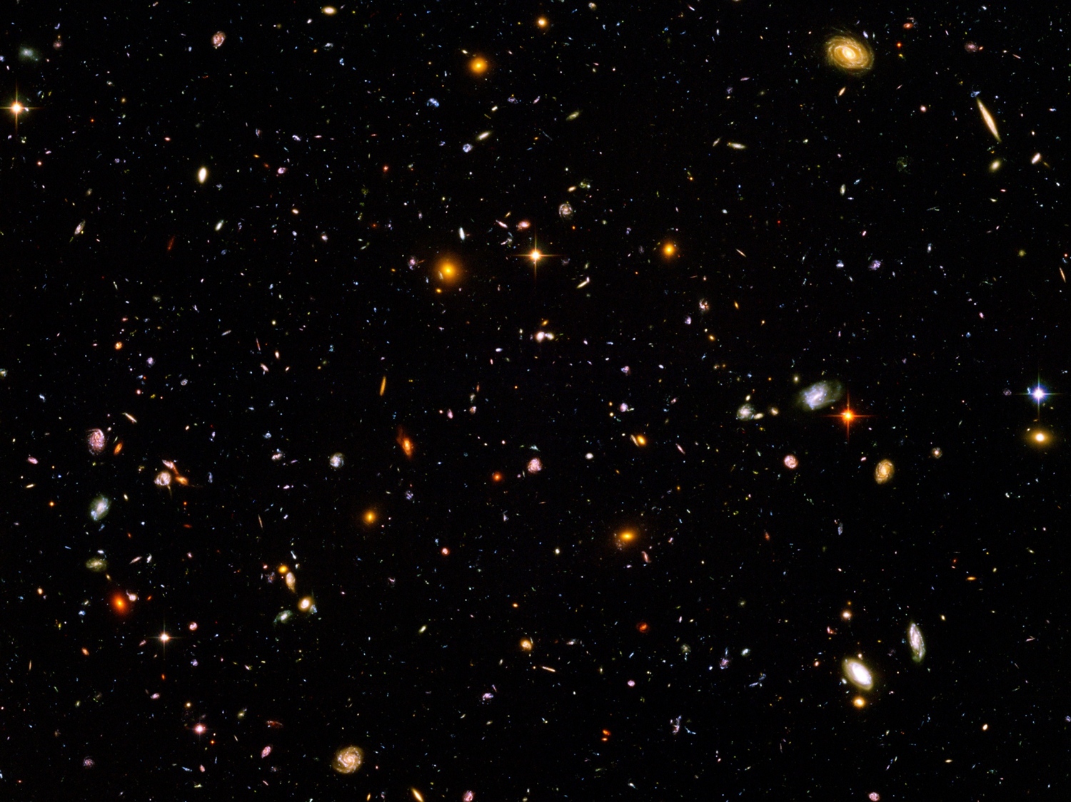
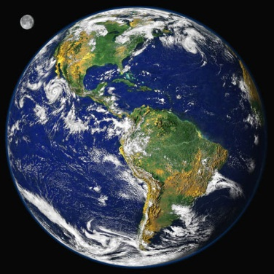
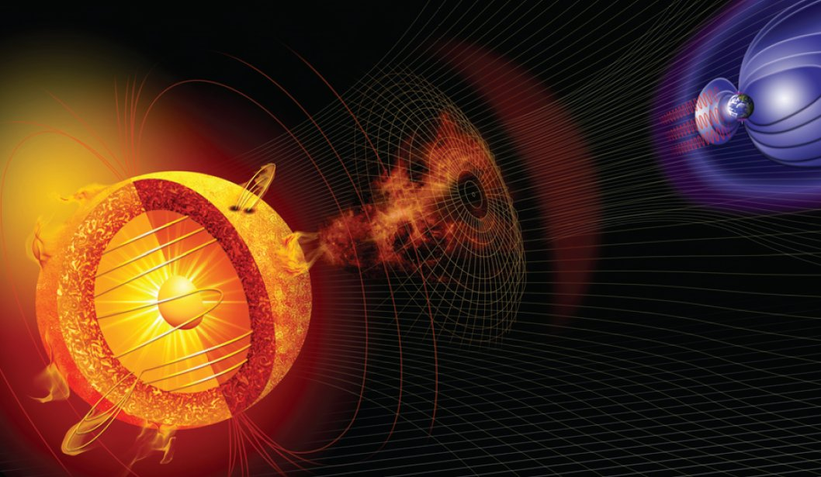
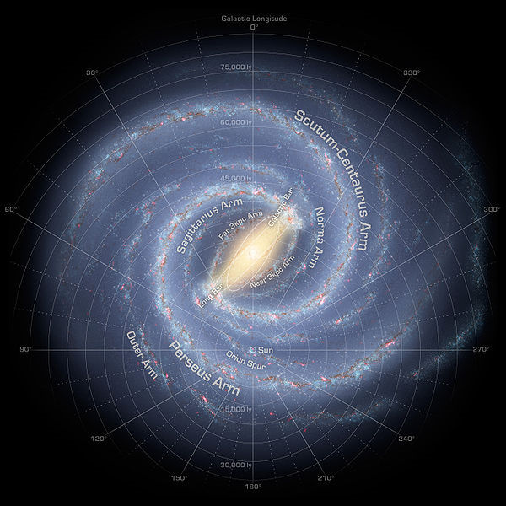
SO HOW DID YOU GET HERE?
ON A PLANET…
GOING AROUND A STAR…
GOING AROUND A GALAXY…
…IN A UNIVERSE FULL OF GALAXIES?

Slide 9
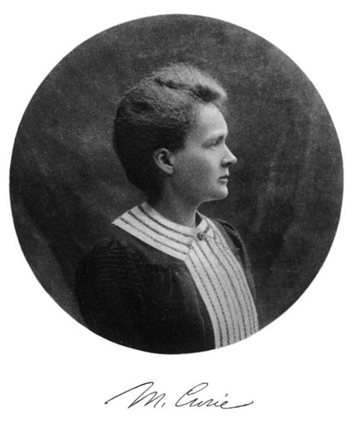
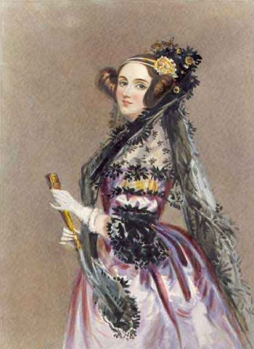
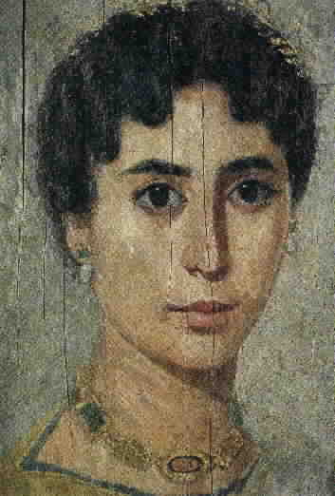
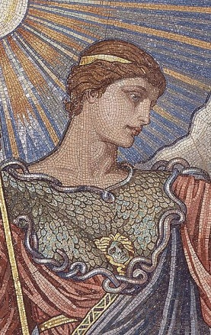
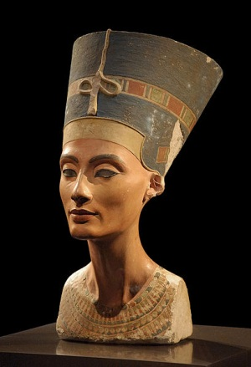
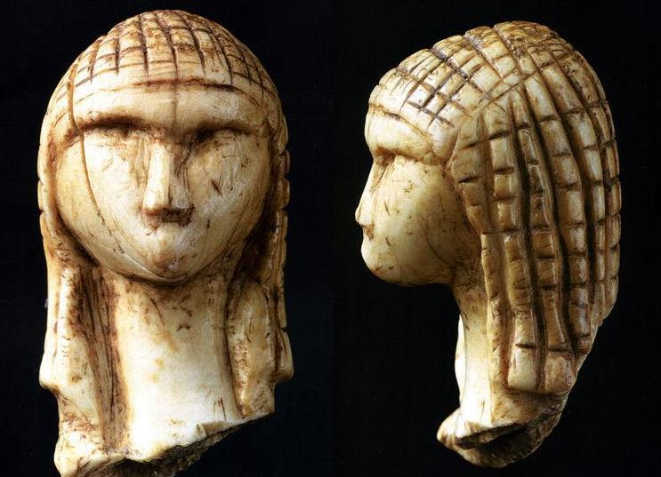
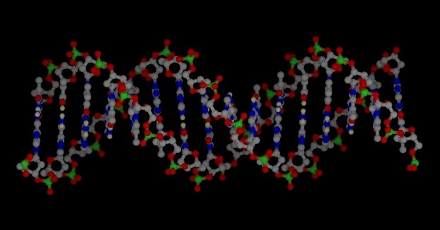
YOU CAME FROM INSIDE YOUR MOMMY. YOUR MOMMY CAME FROM INSIDE YOUR GRANDMOMMY. YOUR GRANDMOMMY CAME FROM INSIDE YOUR GREAT GRANDMOMMY. ON AND ON, BACK THROUGH TIME…
100 BA*
200 BA
1700 BA
2200 BA
3300 BA
25,000 BA
…GREAT GREAT GREAT GREAT GREAT GREAT GREAT GREAT GREAT GREAT GREAT GREAT…
OVER 100,000 GREAT-GRANDMOMMIES AGO
TO A MOMMY WHO LOOKED SOMETHING LIKE THIS:
3,000,000 BA
*BA = “Birthdays Ago”

Slide 10
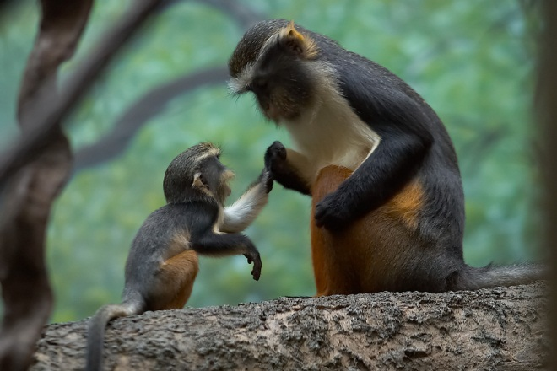
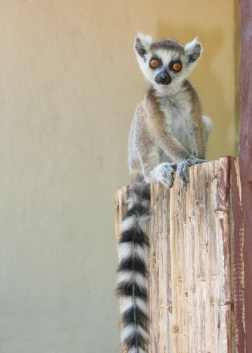
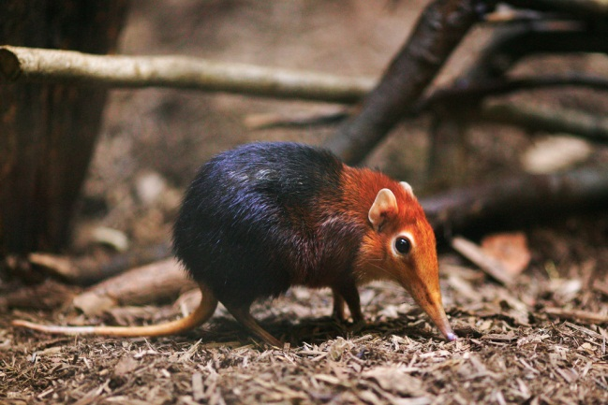
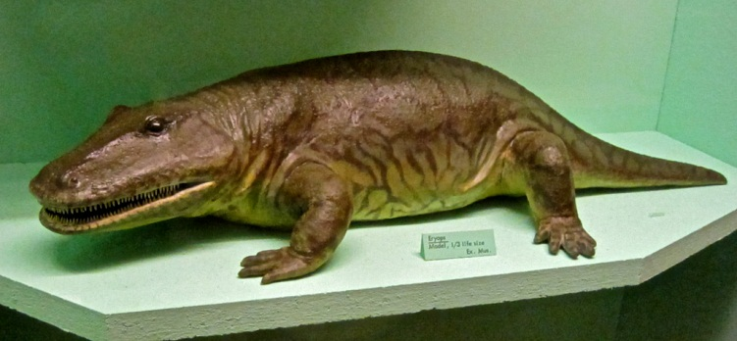
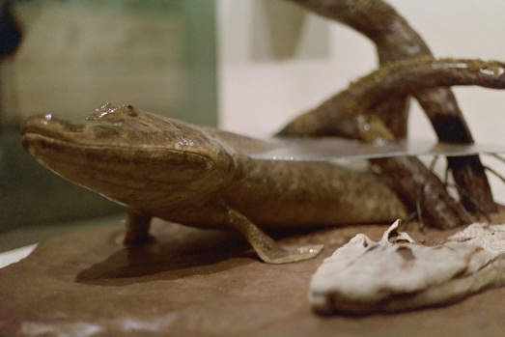
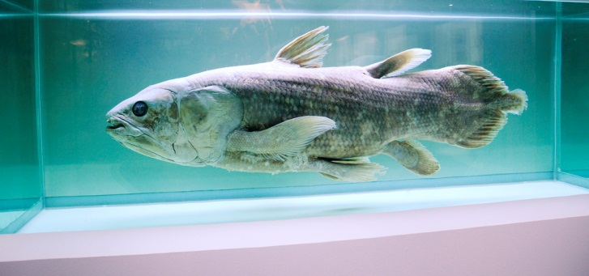
BUT IT DOESN’T STOP THERE! SHE CAME FROM INSIDE HER MOMMY, WHO CAME FROM INSIDE HER GRANDMOMMY, WHO CAME FROM INSIDE HER GREAT-GRANDMOMMY…
ONE MOMMY LOOKED LIKE THIS…
…ANOTHER MOMMY LIKE THIS…
…AND ANOTHER LIKE THIS
20,000,000 BA
60,000,000 BA
210,000,000 BA
ON AND ON…
…BACK THROUGH TIME…
…CHANGING AND CHANGING
295,000,000 BA
375,000,000 BA
480,000,000 BA

Slide 11
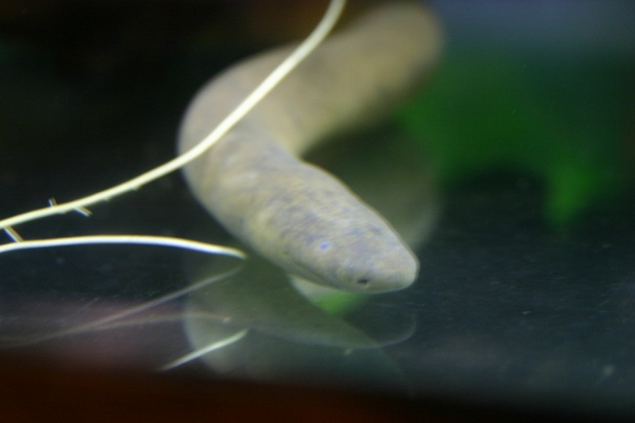
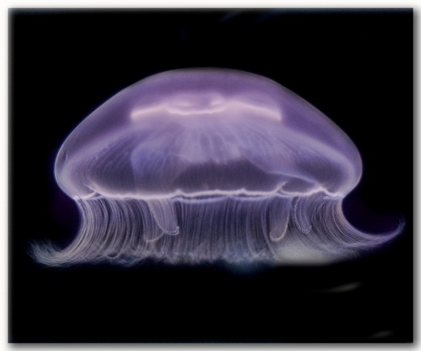
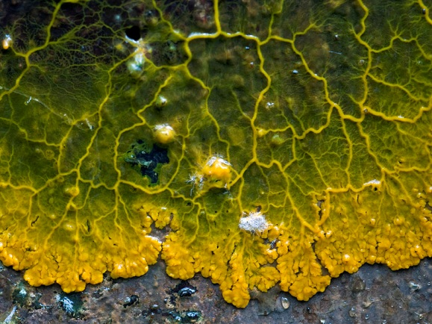
GETTING MORE AND MORE SIMPLE OVER HUNDREDS OF MILLIONS OF YEARS
530,000,000 BA
550,000,00 BA
1,500,000,000 BA
ALL THE WAY BACK TO THIS
A SINGLE CELL
3,500,000,000 BA

Slide 12
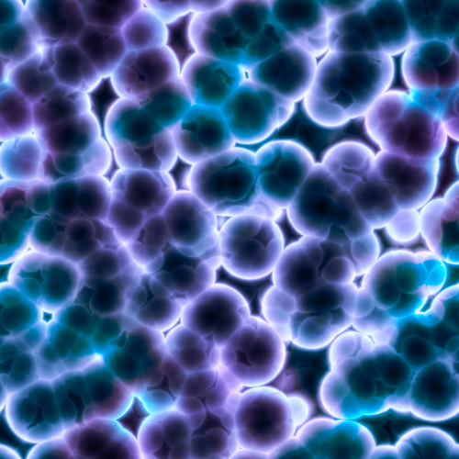
HOW DID A SINGLE CELL BECOME HOMO SAPIENS?
FOR 2,000,000,000 BIRTHDAYS ON EARTH, ALL LIVING THINGS WERE SINGLE CELLS.
THEN SOME CELLS STARTED WORKING TOGETHER.
THIS MADE THEM STRONGER THAN THE SINGLE CELLS, SO THEY MULTIPLIED

Slide 13
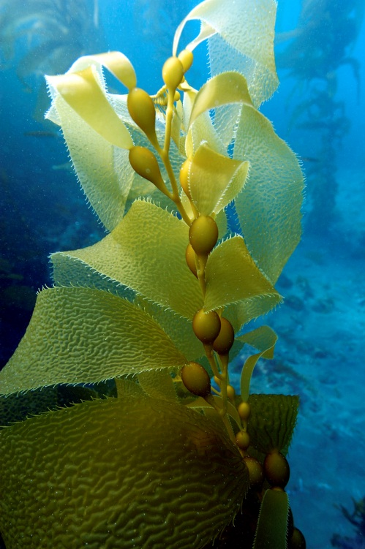
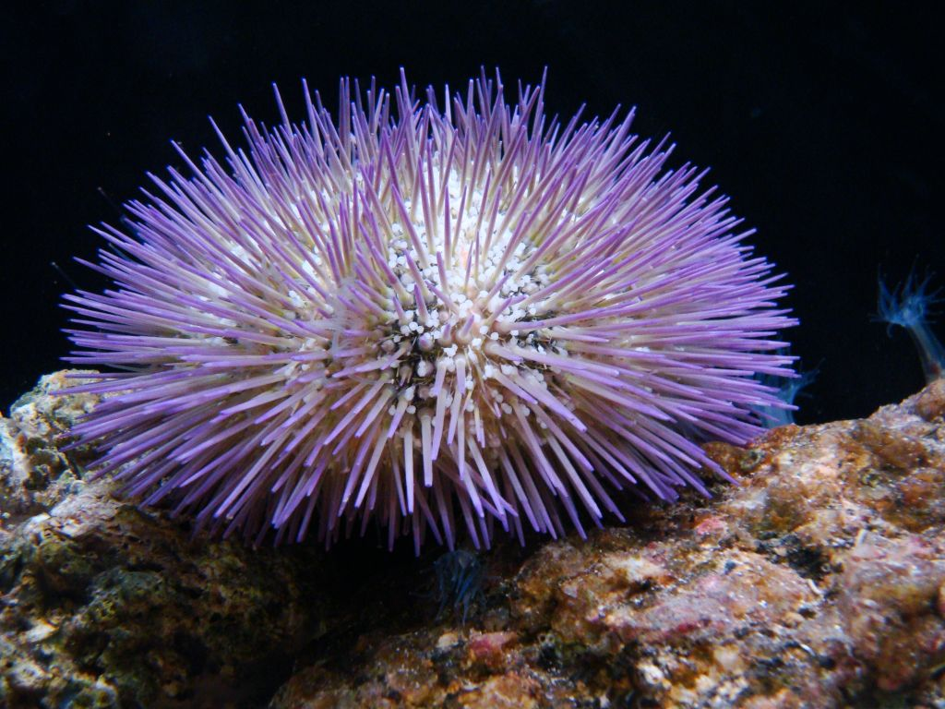
SOME TEAMS OF CELLS FORMED PLANTS THAT EAT SUNLIGHT
OTHERS FORMED ANIMALS,
THAT EAT PLANTS.
DIFFERENT THINGS WORKED FOR
DIFFERENT KINDS OF LIFE.

Slide 14
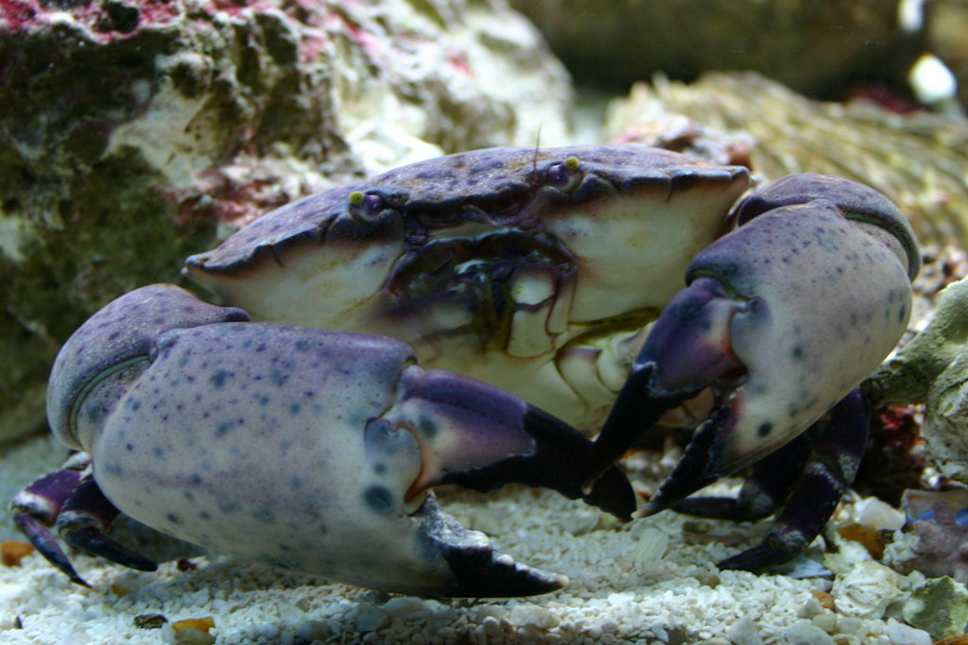
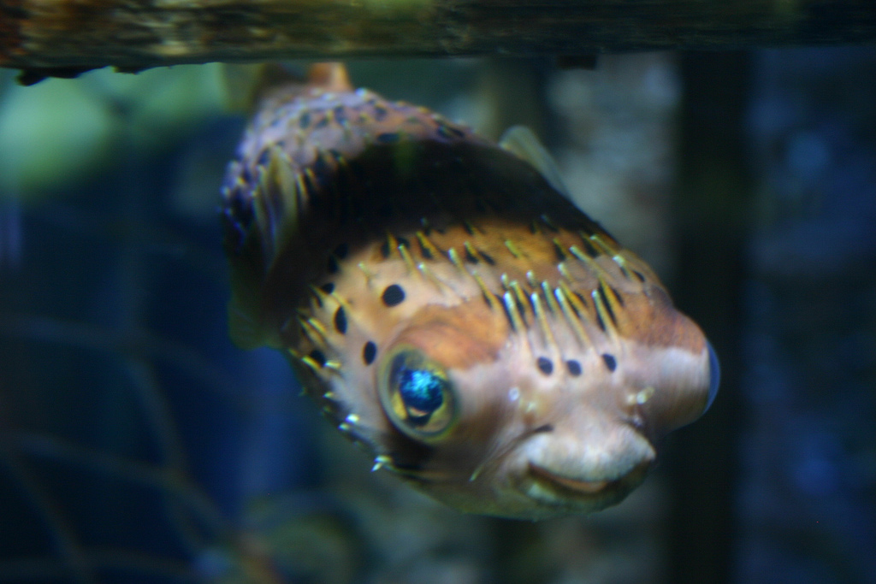
ANIMALS AND PLANTS KEPT ON CHANGING, TRYING OUT DIFFERENT THINGS.
SOME ANIMALS, LIKE CRABS,
WORE THEIR SKELETONS
ON THE OUTSIDE.
OTHER ANIMALS, LIKE FISH,
WORE THEIR SKELETONS
ON THE INSIDE.
DIFFERENT THINGS WORKED FOR DIFFERENT KINDS OF LIFE.

Slide 15
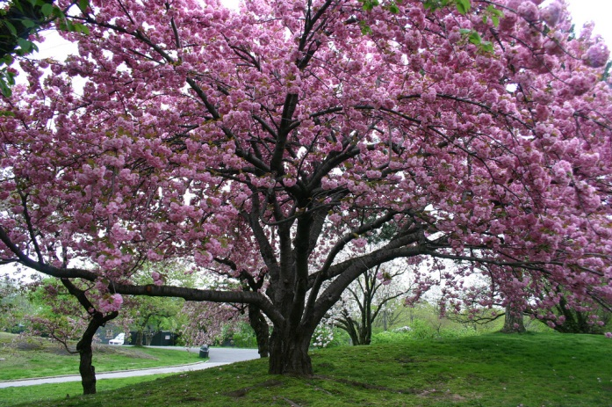
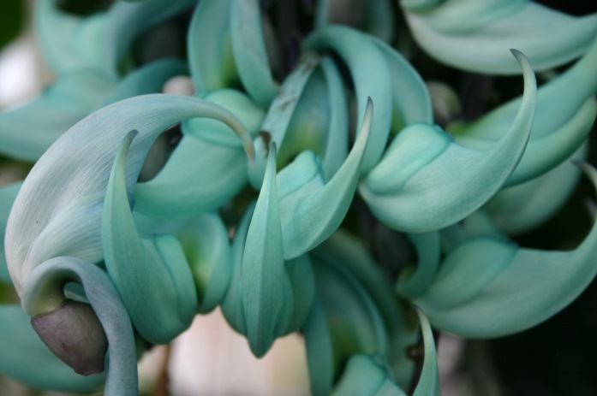
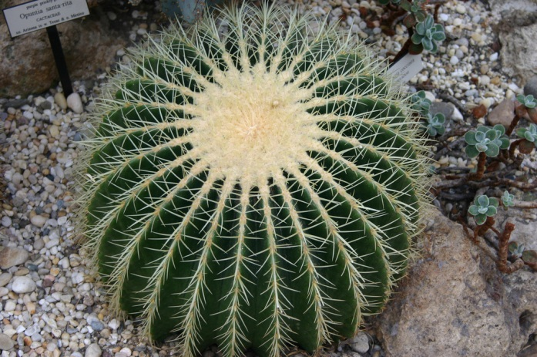
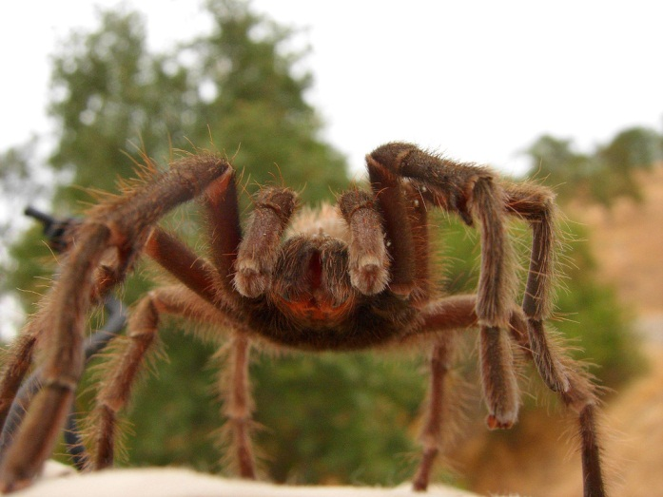
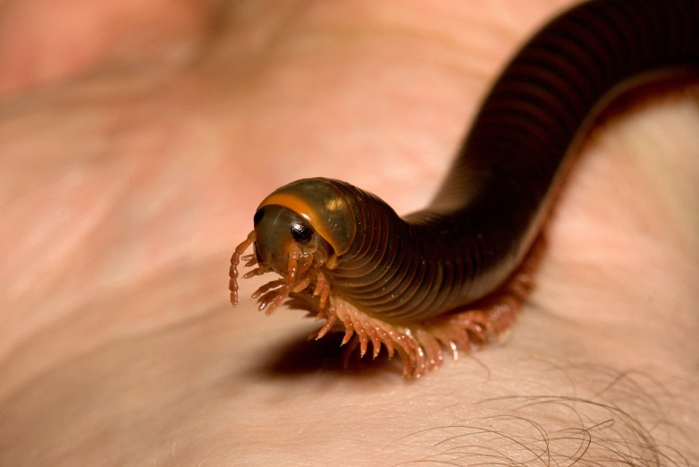
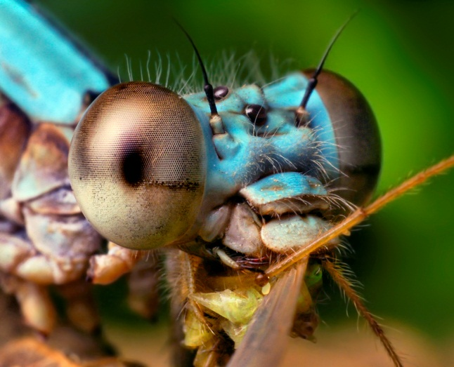
ALL OF THIS WAS HAPPENING IN THE EARTH’S OCEANS, WHICH WERE GETTING PRETTY CROWDED…
SO SOME PLANTS AND ANIMALS GREW TO LIVE ON THE LAND.

Slide 16
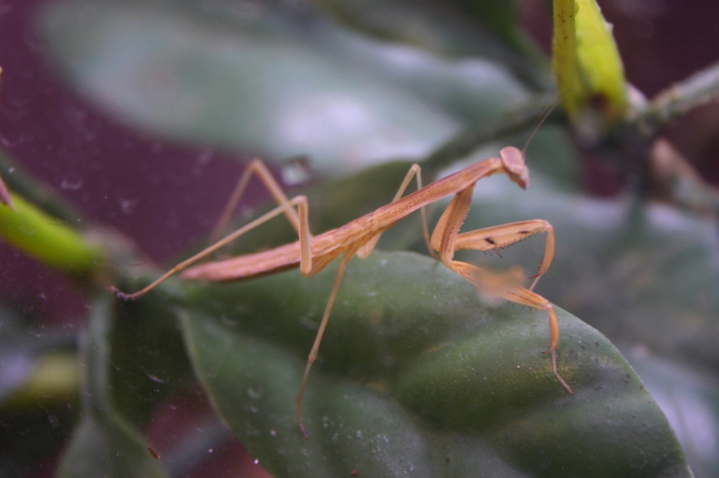
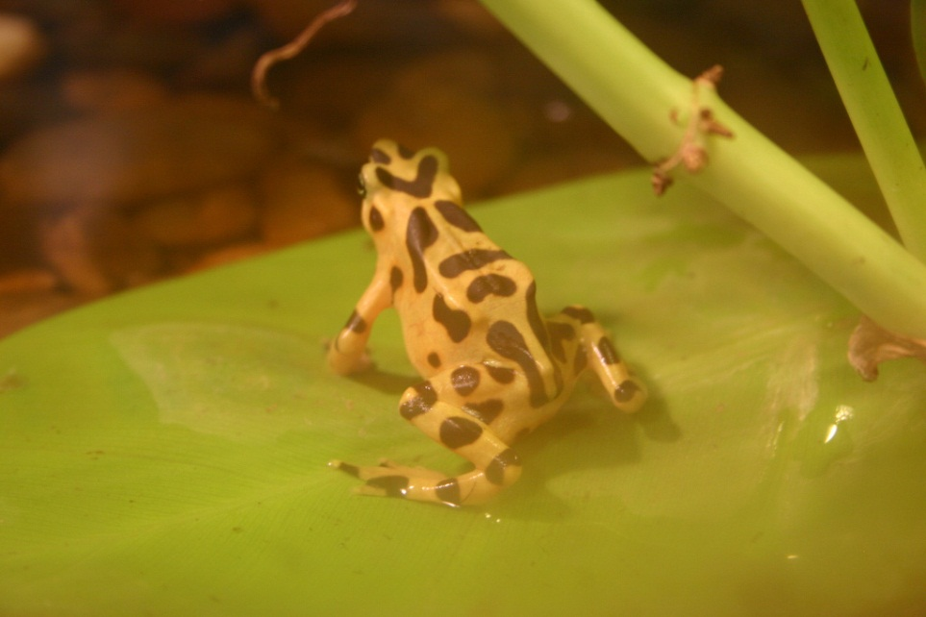
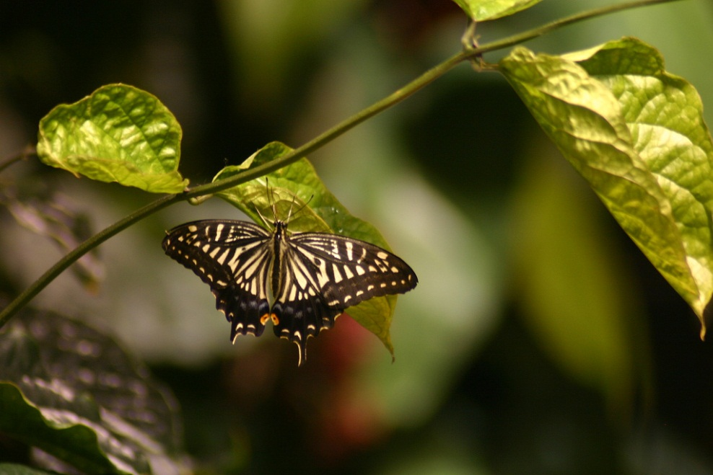
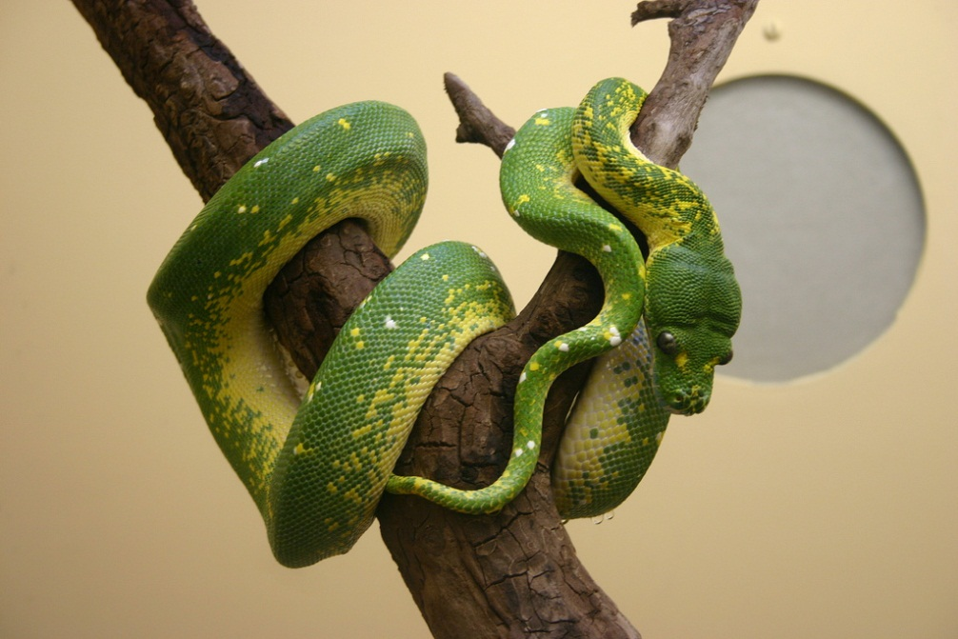
CRABS AND OTHER ANIMALS WITH OUTSIDE SKELETONS BECAME BUGS AND INSECTS.
FISH AND OTHER ANIMALS
WITH INSIDE SKELETONS
BECAME AMPHIBIANS AND REPTILES

Slide 17
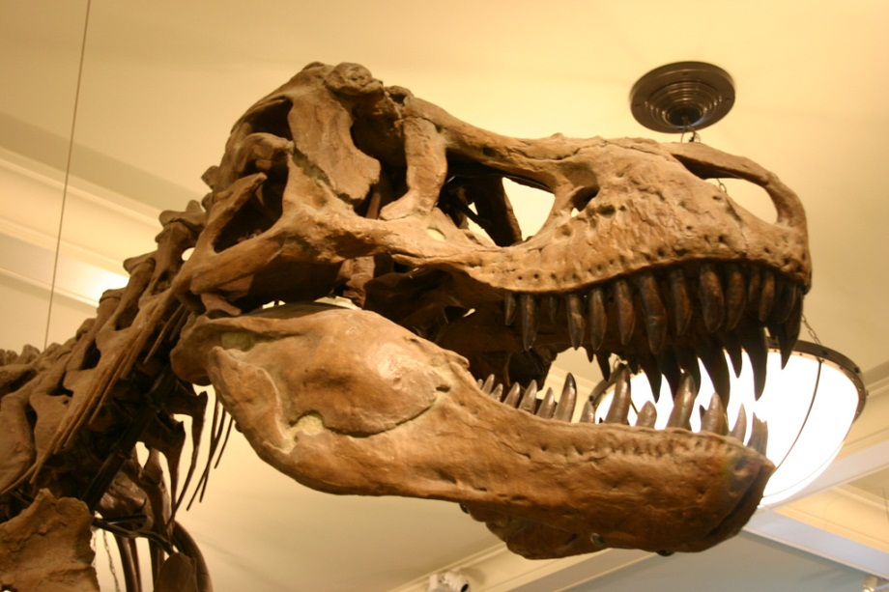
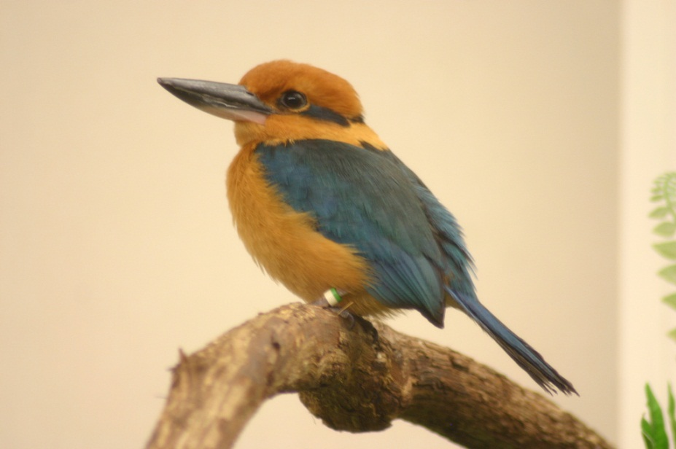
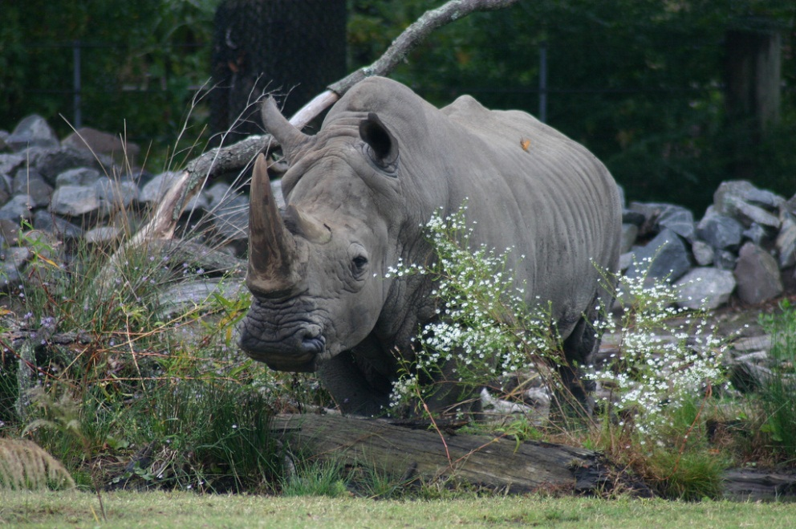
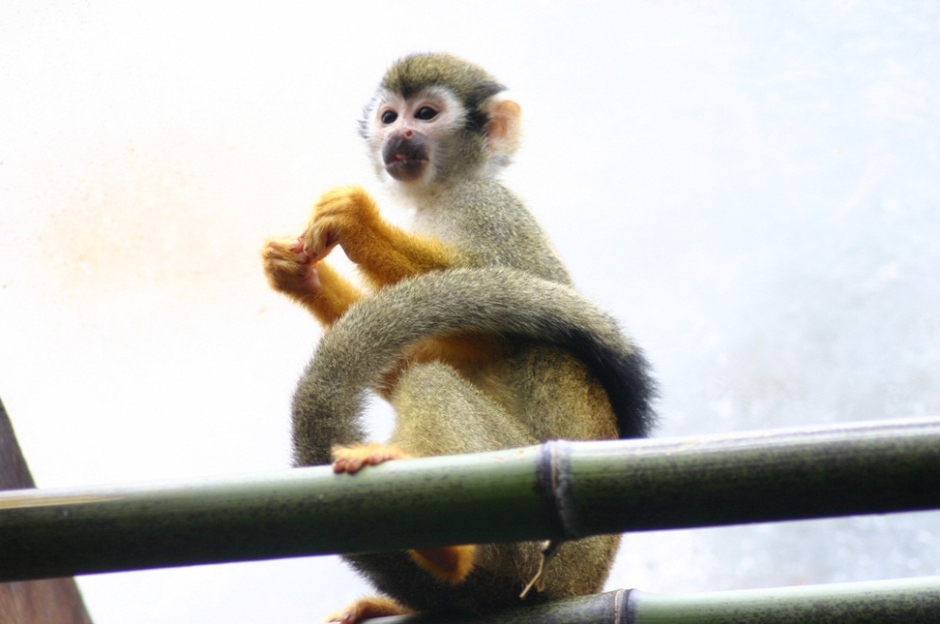
SOME LIZARDS BECAME DINOSAURS AND BIRDS AND TINY MAMMALS.
SOME TINY MAMMALS BECAME ELEPHANTS, DOGS, CATS, WHALES, AND MONKEYS.
SOME MONKEYS EVENTUALLY BECAME HOMO SAPIENS!

Slide 18
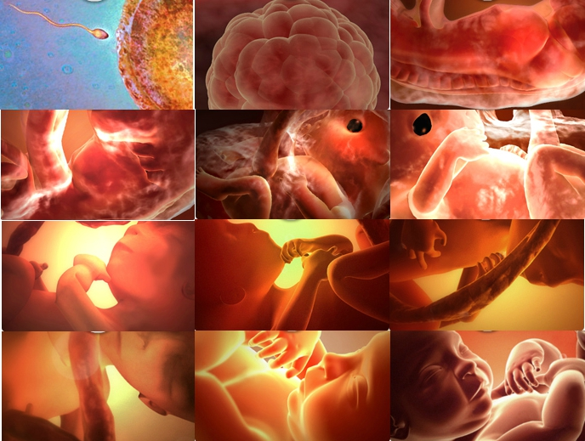
A FEW HOURS LATER YOU GREW UP TO BE THIS
YOU HAD A TAIL LIKE A LIZARD ONCE!
THIS WAS YOU YOUR NUMBER
OF BIRTHDAYS AGO
(PLUS NINE MONTHS INSIDE
YOUR MOMMY.)
YOU HAD GILLS LIKE A FISH
ONCE TOO!
AND EYES ON THE SIDE OF YOUR HEAD LIKE A MOUSE!
YOU GREW
AND GREW
AND GREW
AND GREW
AND GREW
AND GREW
AND GREW

Slide 19
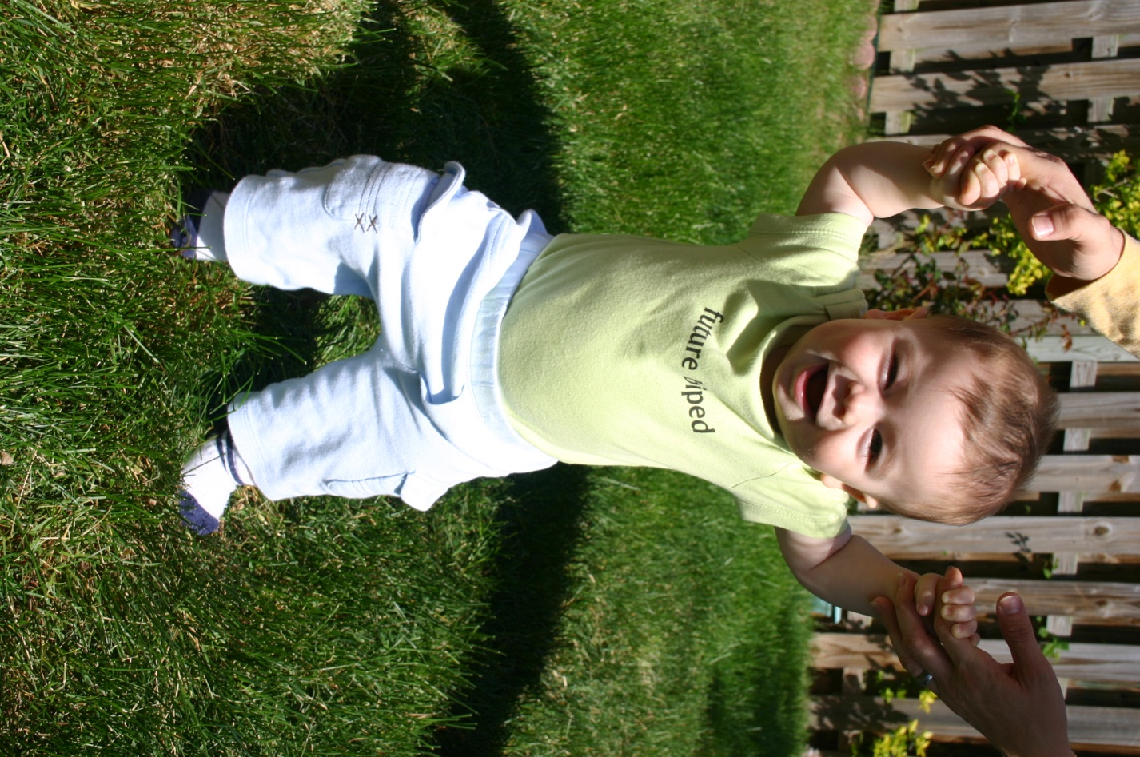
YOU ARE HOMO SAPIENS!
BIG BRAIN!
LOTS OF TEAMS OF CELLS!
OPPOSABLE THUMBS!
WARM BLOODED!
SKELETON ON THE INSIDE!
WALKS ON TWO FEET!

Slide 20
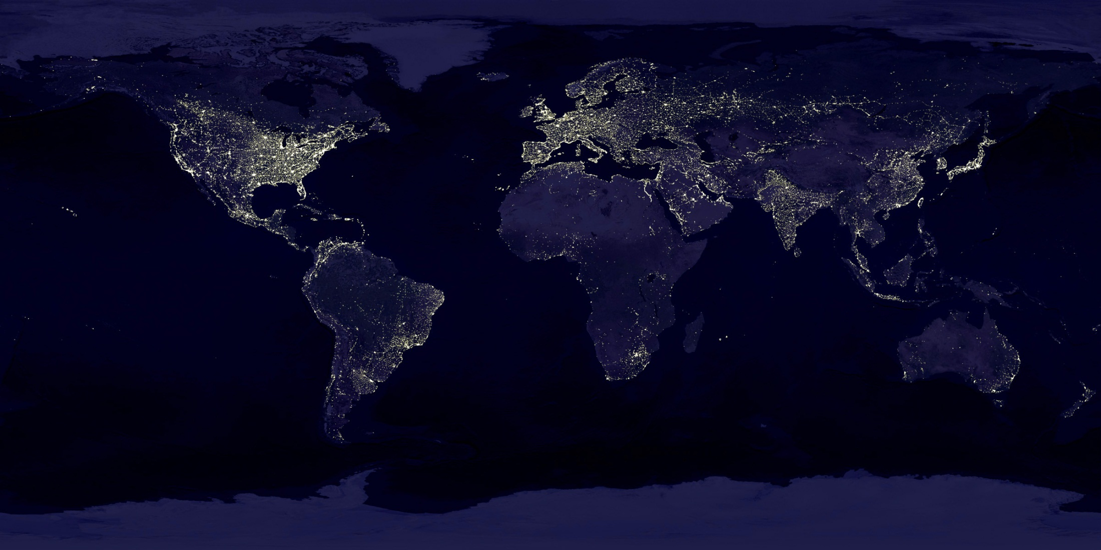
THERE ARE OVER 7,000,000,000 HOMO SAPIENS
ON PLANET EARTH
(PLUS A FEW OUT IN SPACE)
AND ANOTHER FOUR ARE BORN EVERY SECOND!

Slide 21
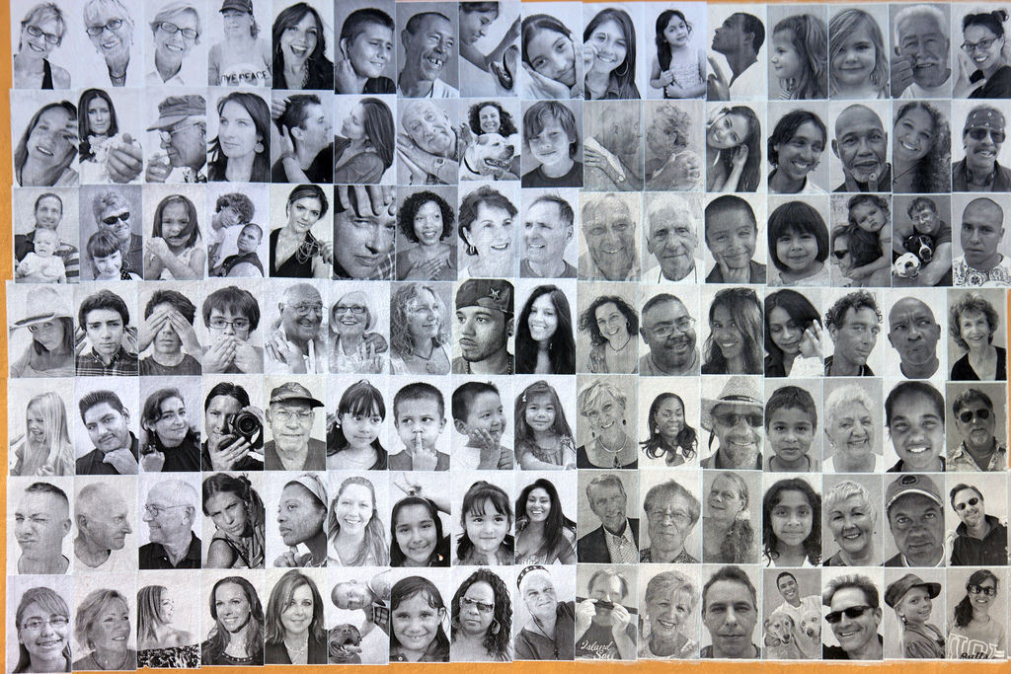
EVERY HOMO SAPIENS IS UNIQUE.

Slide 22
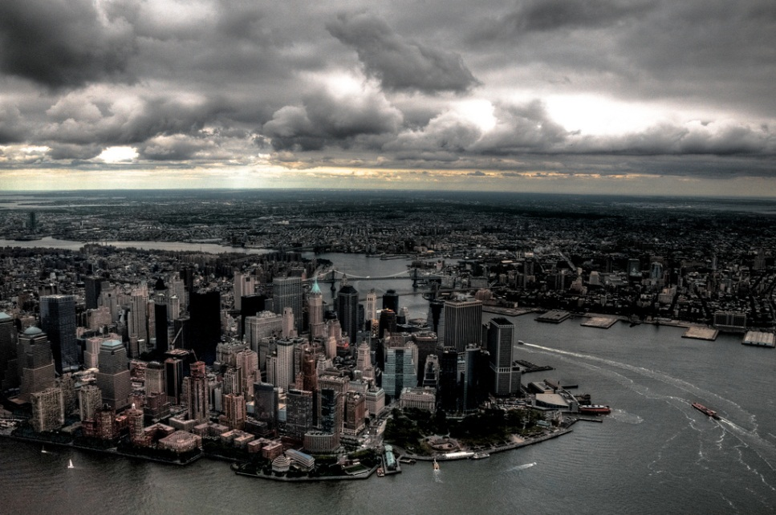
BUT WE ARE ALL PART OF A TEAM CALLED
CIVILIZATION
NEW YORK
DUBAI
RIO DE JANERO
HONG KONG

Slide 23
OUR CIVILIZATION ISN’T PERFECT
BUT WE ARE ALWAYS WORKING TO MAKE IT BETTER
MEDICINE
TECHNOLOGY
SCHOOLS
EXPLORATION

Slide 24
EVERY BIRTHDAY WE ARE SMARTER THAN WE WERE ON THE LAST BIRTHDAY,
JUST LIKE YOU GET SMARTER TOO
AS YOUR GUARDIAN
MY PURPOSE IS TO HELP YOU GROW UP
TO BE AS GOOD AS ME AT LIFE AND CONTRIBUTING TO CIVILIZATION.
YOUR PURPOSE IS TO GROW UP TO BE
EVEN BETTER THAN ME!

Slide 25
HOPEFULLY THIS BOOK HAS FILLED YOU WITH QUESTIONS
HERE’S SOME OF MY FAVORITE QUESTIONS
WHERE DID THE DINOSAURS GO? (HINT: LOOK UP IN THE SKY AND TREES)
WHY DOESN’T THE MOON ALWAYS LOOK ROUND?
CAN YOU FIND YOUR HOUSE ON GOOGLE EARTH?
IS THERE LIFE ON OTHER PLANETS? (HINT: SETI, EXOPLANETS)
DOES THE EARTH HAVE A BIRTHDAY? (HINT: EQUINOXES, SOLSTICES)
WHAT DOES IT MEAN THAT FOUR HOMO SAPIENS ARE BORN EVERY SECOND? (TRY COUNTING IN MULTIPLES OF FOUR)
CAN YOU FIND THE PLANETS ON GOOGLE SKY?
CAN YOU FIND AND NAME THE ANIMALS AND PLANTS IN THIS BOOK?
EVERYTHING ON EARTH IS POWERED BY THE SUN, EVEN YOU. CAN YOU FIGURE OUT HOW YOU ARE POWERED BY THE SUN? CAN YOU FIGURE OUT HOW A CAR, LIGHT BULB, OR RIVER RUNS ON THE SUN?
WHAT MAKES IT COLD IN THE WINTER AND WARM IN THE SUMMER?
ANIMALS AND PLANTS CHANGING OVER BILLIONS OF YEARS IS CALLED “EVOLUTION,” IS LIFE STILL EVOLVING TODAY? ARE PEOPLE EVOLVING STILL?
WHERE DID THE FIRST CELL COME FROM?

Slide 26
This book would not be possible without these Public Domain and Creative Commons Photos:
Cover - Andes Hike by Trey Ratcliff http://www.flickr.com/photos/stuckincustoms/3410667874/
Page 4 - Sun by Pranav Yaddanapudi: http://www.flickr.com/people/neychurluvr/
Page 5 - Moon by Anita Ritenour http://www.flickr.com/photos/puliarfanita/4927482821/
Page 3, 6 , 7, 8, 20 Photos by NASA
Page 9 - Marie Curie, Ada Lovelace, Hypatia, Minerva, Nefertiti, and Woman from Brassempou in Public Domain
Page 10 – 11
A Mother's Touch by Eric Heupel http://www.flickr.com/photos/eclectic-echoes/54629630/
Ring Tail Lemur in Berenty by David Dennis http://www.flickr.com/photos/davidden/2269694846/
African Giant Shrew - A Fascinating One by Joey M. http://www.flickr.com/photos/jomak14/2836615665/
Eryops by ellenm1 http://www.flickr.com/photos/ellenm1/4261041794/
Tiktaalik by Linden Tea http://www.flickr.com/photos/linden_tea/5212816060/
Coelacanth by Sini Merikallio http://www.flickr.com/photos/smerikal/6227540054/
Aquatic Caecilian by Brian Gratwicke http://www.flickr.com/photos/briangratwicke/3014114826/
Jellyfish by Giorgos Vintzileos http://www.flickr.com/photos/vintzileos/2732523414/
Slime Mold by Richard Droker http://www.flickr.com/photos/29750062@N06/4148954138/
Single Cell by Wikipedia User Perezoso http://commons.wikimedia.org/wiki/File:SFRP1_64cell.jpg
Page 12
Cells by Patrick Hoesly http://www.flickr.com/photos/zooboing/3662883261/
Multicellular by Daniel Kulinski http://www.flickr.com/photos/didmyself/6312323838/
Page 13
Kelp by NOAA http://www.flickr.com/photos/usoceangov/4115872878/
Sea Urchin by cassimano http://www.flickr.com/photos/cassimano/2522688766/
Page 15
Plants by Ryan Somma
Tarantula by calwest http://www.flickr.com/photos/mwestcalifornia/256897572/
Milipede by e_monk http://www.flickr.com/photos/e_monk/4195187637/
Damselfly by Thomas Shahan http://www.flickr.com/photos/opoterser/2651845380/
Page 18
Images by NHS Human Services
Page 21
A Face in the Crowd (detail) by Michelle Tricca Photography http://www.michelletricca.com/
http://www.flickr.com/photos/colemama/5743773308/
Page 22
New York by Nathan Siemers http://www.flickr.com/photos/nosha/3043953285/
Rio de Janero by Ashley Ringrose http://www.flickr.com/photos/mrtruffle/2832477421/
Dubai by Kamel Lebtahi http://www.flickr.com/photos/klebtahi/4691365686/
Hong Kong Skyline by Spreng Ben http://www.flickr.com/photos/sprengben/4315145017/
Page 23
Eastern Virginia Medical School by Wugging Gavagai http://www.flickr.com/photos/the10101/3998377171/
Large Hadron Collider by CERN http://www.flickr.com/photos/johnmcnab/4248698746/
Oxford by Fr Lawrence Lew, O.P. http://www.flickr.com/photos/paullew/3521964549/
ISS - NASA
Page 24
Yosemite by Justin Kern http://www.flickr.com/photos/justinwkern/5756196362/
Page 14, 16, 17, 19 Photos by Ryan Somma

